Slide 1


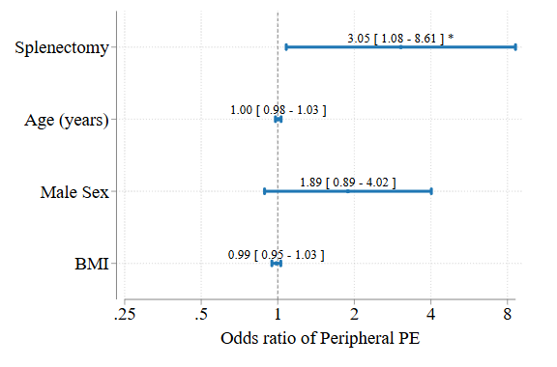
Splenectomy Is Associated with Peripheral PE Location, Implications for CTEPH Pathogenesis
Darren White, MD (1), Brian Locke, MD MSc (2), Kaan Raif, MD (3), Mark Dodson, MD PhD (2).
University of Utah Pulmonary and Critical Care Fellowship
Intermountain Medical Center Division of Pulmonology and Critical Care
University of Utah Division of Internal Medicine Residency
Independent Predictors of PE Location
Rationale
Splenectomy and Chronic Thrombembolic Pulmonary Hypertension (CTEPH) are associated beyond what would be explained by increased VTE risk alone.
Differences in the location or clot burden at acute PE diagnosis might help explain the excess CTEPH risk, but have not been previously characterized.
Methods
Retrospective, matched cohort study:
Patients admitted for PE +/- splenectomy (identified by natural language processing)
Two Utah Hospitals 2003-2020.
Duplicate, independent physician review of CT imaging.
Qanadli index (burden)
Classified peripheral or central. .
Poisson & Logistic regressions, controlling for Age, Sex, and BMI.
Unadjusted comparisons of secondary data points (Wilcoxon Rank-sum & Chi-Square tests)
Results
High agreement between CT review (Kappa 0.71)
Splenectomy independently associated with peripheral PE (adjusted odds ratio: 3.05 [1.1-8.6])
No difference in PE burden between groups
Splenectomy group more like to have
2+ weeks of symptoms (p = .044)
no DVT at PE diagnosis (p = .002)
Discussion
Patients with splenectomy had more peripheral PEs, but similar clot burden and RV strain.
Splenectomy may predispose to CTEPH due to:
recurrent small volume venous thromboembolism
Non-lower extremity thrombosis ( e.g. in-situ?)
Limitations: unblinded review
Next Steps
***
Splenectomy patients have higher odds of peripheral PE compared with patients who have not had splenectomy.
 | No Splenectomy | Splenectomy | p-value
N | 100 | 40
Age at index PE | 61 (52,73) | 56 (41,66) | 0.013
Male Sex | 48% (48) | 35% (14) | 0.16
PE severity index (PESI) | 97 (75,120) | 89 (66,111) | 0.097
PA Enlargement (CT) | 71% (71) | 68% (27) | 0.68
RV to LV ratio (CT) | 1.07 (0.88,1.31) | 1.07 (0.94,1.35) | 0.31
RV to LV ratio abnormal (>1 by CT) | 55% (55) | 70% (28) | 0.10
Troponin (max) (ng/mL) | 0.01 (0.01,0.08) | 0.01 (0.01,0.03) | 0.067
BNP (max) (pg/mL) | 62 (18,306) | 49 (24,110) | 0.70
Peripheral PE | 37% (37) | 52% (21) | 0.093
Qanadli Score (Avg) | 0.22 (0.08,0.48) | 0.13 (0.06,0.34) | 0.32
Duration of Symptoms ≥ 2 weeks | 8% (8) | 20% (8) | 0.044
DVT found within 2 weeks | 71% (48) | 35% (8) | 0.002
Splenectomy patients are yopunger, more likely to have >2 weeks of symptoms, less likely to have DVT found within 2 weeks of PE.

